Slide 1
Specification test techniques
Prepared by: Jacek Okrojek
13 October 2015
Version: 1.0

Slide 2

Agenda
Use case testing
Scenario based testing
Test case
Summary
Additional materials
https://github.com/jacekokrojek/math.uni.lodz.pl

Slide 3
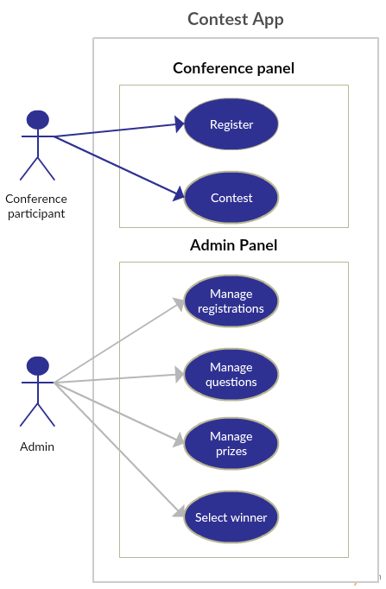
Use case testing
Use cases are common method to describe system functions.
A use cases specifies a sequence of actions, including variants, that the system can perform and that yields an observable result of value to a particular actor
Each use cases should be covered at least by one test however usually one test case in not enough.
Concepts within the use case:
Actor: a person, process or external system that interacts with your product.
Action: An action results in a change of state and is realized by sending a message to an object or modifying a value in an attribute.
Goal: The goal is to reach a desired state of the system.

Slide 4
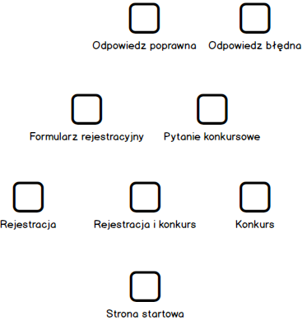
Use case testing
Use cases can be defined as
Informal text
Using Alistair Cockburn template
Flow chart
State diagrams
Use Case: Register
Goal in Context: Conference participant would like to stay in touch with potential employer
Preconditions: No
Success End Condition: Contact details stored
Failed End Condition: Contact details not stored
MAIN SUCCESS SCENARIO
1. Participant press 'Stay in touch'
2. Participant enters all his contact details
3. Participant submits form
EXTENSIONS
2a. Invalid email address
2a1. Pop up is shown
3a. Candidate abort action

Slide 5
Use case testing
In case of informal text
Brainstorm and list the primary actors
Brainstorm and exhaustively list user goals for the system
Capture the summary goals (higher-level goals, which include several sub-goals. These capture the meaningful benefits offered by the system).
Select one use case to expand.
Capture stakeholders and interests, preconditions and guarantees.
Write the main success scenario.
Brainstorm and exhaustively list extension conditions (such as alternate sequences to achieve the same result, or sequences that lead to failure.)
Use Case: Submitting form with user data.

Slide 6
Use case testing
Encourages the tester to:
Identify the actors in the system
Human
Other processes or systems
Inventory the possible actor goals
Identify the benefits of the system (via identifying the summary goals)
Develop some method (sequence diagrams, outlines, textual descriptions, whatever) for describing a sequence of actions and system responses that ultimately lead to a result.
Develop variations of a basic sequence, to create meaningful new tests.
A use case based approach to testing provides a good starting point if you don’t know much about the application.
Provides a structure for tracing through the application
As simple as function testing but works several functions together
Notes:
Create uses case for ...

Slide 7
Scripted Test case
Scripted testing requires tester to write precise test instruction for test.
Test can be written based on documentation, without working software.
Attributes of the test case
Id, Title, Description, Priority, Status
Environment Duration (optional)
Complexity (optional)
Creator (optional)
More
Test Instruction
Preconditions (optional)
Steps
Action
Expected Result
Post conditions (optional)
Visit https://moztrap.mozilla.org to see sample manual test for real applications
Visit https://quality.mozilla.org/ to support Mozilla testing community
Specification at https://wiki.mozilla.org/Features/Release_Tracking#Almost_Definitely_in_Firefox_43
Notes:
Create test cases

Slide 8
Tractability matrix
Tractability matrix is used in order to make sure that all use cases are covered by tests.
Each uses case should be mentioned in the tractability matrix and at least one test cases should test each use case
 | TC_1 | TC_2 | TC_3 | TC_4 | TC_5
Contest | x | x
Registrations |  |  | x
Prizes |  |  |  | x
Lotery |  |  |  |  | x
Notes:
Create test cases

Slide 9
Scenario based testing
A scenario is a coherent story about how someone uses (or tries to use) the program.
A scenario test uses a scenario as a tool for evaluating a program’s behaviour. The elements of the story (adapted from Carroll, 1999)
Setting
Agents or actors
Goals or objectives
Motivations and emotions
Plot (sequences of actions and events)
Actions & events can change the goals
Sample scenario: Contest application should help in building company new image on a large testing conference. Valuable prizes should attract many participants that may use application at the same time.
Set up enough questions for big number of participants.
Check if application is fast enough when many users access it at the same time
Verify if exporting huge number of registration to excel works as expected.
Varify that users can easily discover how to use application.
Varify that application can display large images of main prizes.

Slide 10
Scenario based testing
KAHN'S LIST OF BENEFITS OF SCENARIO BASED THINKING
Call attention to the larger range of possibilities that must be considered in the analysis of the future
Dramatize and illustrate the possibilities
Force analysts to deal with details and dynamics that they might avoid if they focus on abstract considerations
Illuminate interactions of psychological, social, economic, cultural, political, and military factors, including the influence of individual personalities ... in a form that permits the comprehension of many interacting elements at once.
Consider alternative possible outcomes of certain real past and present events

Slide 11
Scenario based testing
Ideal scenario test has several characteristics:
The test is based on a coherent story about how the program is used, including goals and emotions of people.
The story is credible. Stakeholders will believe that something like it probably will happen
The story is motivating. A stakeholder with influence will advocate for fixing a program that failed this test.
The story involves complexity: a complex use of the program or a complex environment or a complex set of data.
Test results are easy to evaluate. This is important for scenarios because they are complex.
Many test techniques tell you how the program will behave in the first few days that someone uses it.
Good scenario tests go beyond the simple uses of the program to ask whether the program is delivering the benefits it should deliver
Good scenarios often give you insight into frustrations that an experienced user will face - someone who has used the program for a few months and is now trying to do significant work with the program

Slide 12
Scripted tests
Advantages
?
Disadvantages
?

Slide 13
Testing in the software life
Early testing and testing approaches
Structural tests - Developer creates class or function
Domain testing – Part of the module is ready
Use case testing – Module is ready
Scenario based testing – System is ready
Early testing allows for more detailed and cost effective testing
Imagine scenario with several steps that needs to be executed several times to cover all variants of inputs
It is difficult to avoid testing some cases at many levels – it is usually more efficient to check such cases many times then to find strategy to avoid double checking.

Slide 14
Task 3
Register yourself in https://hiptest.net/
Read a manual or watch introduction movie
Create project RCApp
Add following project members jacek.okrojek@gft.com, rafal.nikiel@gft.com
For each use case add separate directory
Create test cases based on specification from lesson-4 directory
Additional materials and references
Parts of this presentaton were taken from http://www.testingeducation.org/BBST/testdesign/

Slide 15
Thank you!

